Slide 1

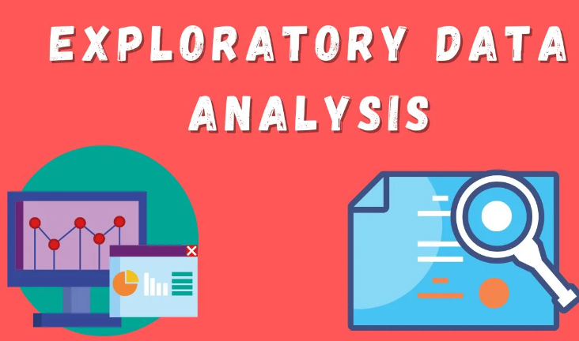
Exploratory Analysis of 'mtcars' Dataset
Name : V.Madhurya
Roll No : 22P31A0538
College Name:ACET
SECTION : CSE-A
.

Slide 2
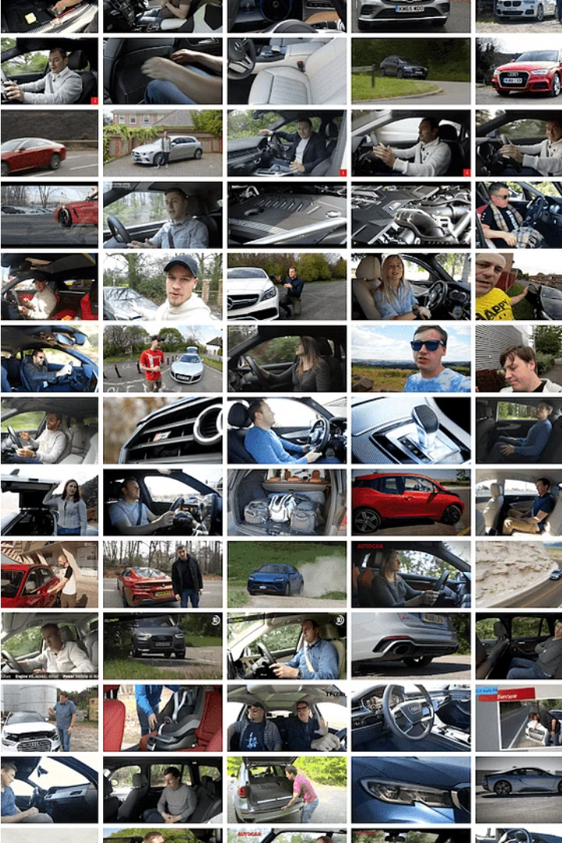
Introduction to the "mtcars" Dataset
The "mtcars" dataset is a classic dataset in the R programming language, containing information on 32 different automobile models. It provides a valuable resource for practicing data analysis and visualization techniques.
.

Slide 3
Descriptive statistics: mean MPG and horsepower standard deviation
To gain a deeper understanding of the key characteristics of the mtcars dataset, we'll begin by analyzing the mean miles per gallon (MPG) and the standard deviation of horsepower.
Mean MPG
23.94
Horsepower Standard Deviation
64.76
The average MPG across the vehicles in the dataset is 23.94, indicating that the typical car gets just under 24 miles per gallon. The standard deviation of horsepower is 64.76, showing a wide range of engine power represented in the data.

Slide 4
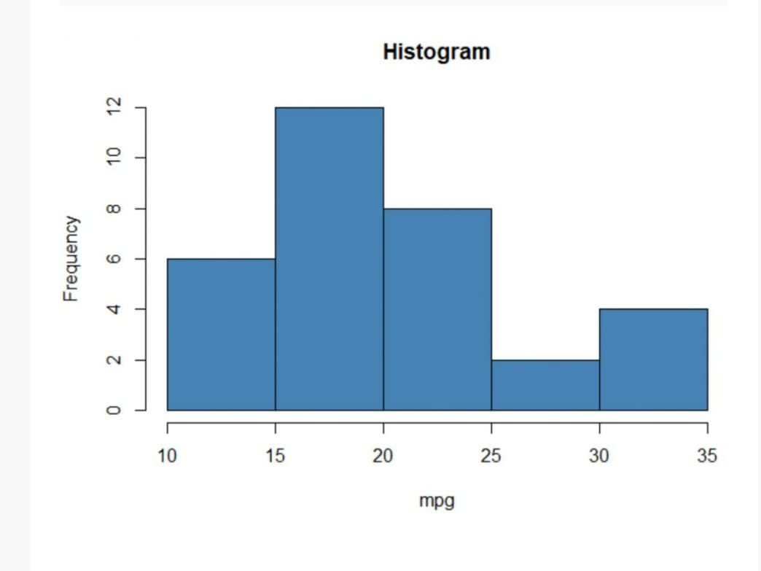
Histogram: Visualizing the Distribution of the Data
To gain a deeper understanding of the "mtcars" dataset, we'll start by visualizing the distribution of the data through a histogram. This powerful graphical tool allows us to see the spread and shape of the variable's values, revealing key characteristics like central tendency, skewness, and potential outliers.

Slide 5
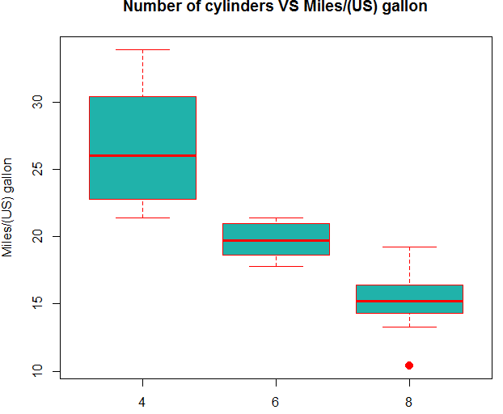
Interpreting the Boxplot
In R programming, a boxplot is a graphical representation of the distribution of a dataset based on five summary statistics: minimum, first quartile (Q1), median, third quartile (Q3), and maximum. It displays these statistics as a box with whiskers, where the box spans from Q1 to Q3 with the median marked inside, and the whiskers extend to the minimum and maximum values of the data, with potential outliers plotted individually. Boxplots are useful for visualizing the spread, skewness, and potential outliers in the data distribution. They can be created using the `boxplot()` function in R.

Slide 6
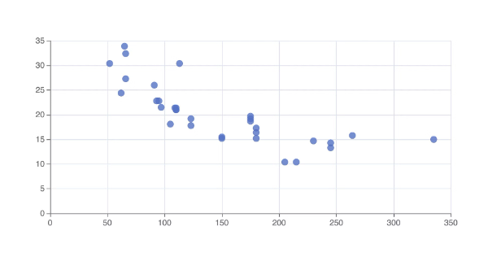
Scatterplot: Exploring the Relationship Between Variables
A scatterplot is a powerful visualization technique that allows us to explore the relationship between two variables in the mtcars dataset. By plotting the values of one variable (e.g., horsepower) against another (e.g., miles per gallon), we can identify patterns, trends, and potential correlations.
Analyzing the scatterplot can provide valuable insights into how these variables are associated, which is an important step in understanding the underlying dynamics of the dataset.

Slide 7
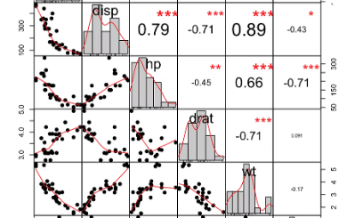
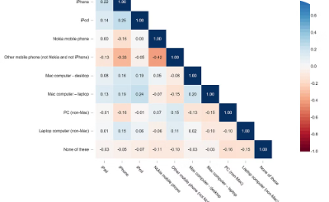
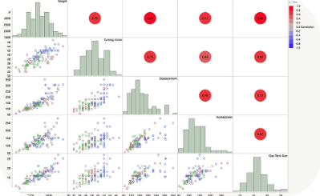
Correlation plot: analyzing the correlation between variables
Visualizing Relationships
Understanding the Correlation Matrix
Exploring Variable Relationships
The correlation plot provides a visual representation of the strength and direction of relationships between variables in the dataset. This allows us to quickly identify which variables are strongly correlated.
The correlation matrix displays the correlation coefficients between all pairs of variables. The values range from -1 to 1, indicating negative, positive, or no correlation.
A scatterplot matrix provides a grid of scatterplots showing the pairwise relationships between all variables. This helps uncover complex patterns and potential nonlinear relationships.

Slide 8




T-test: Hypothesis Testing to Compare Groups
Understand Assumptions
The t-test requires that the data follows a normal distribution and has equal variances between groups.
Formulate Hypotheses
Establish the null and alternative hypotheses to determine if there is a significant difference between the groups.
Calculate the Test Statistic
Compute the t-statistic based on the sample means, standard deviations, and sample sizes of the two groups.
Interpret the P-value
Determine the probability of observing the test statistic if the null hypothesis is true. This p-value guides the decision to reject or fail to reject the null hypothesis.

Slide 9
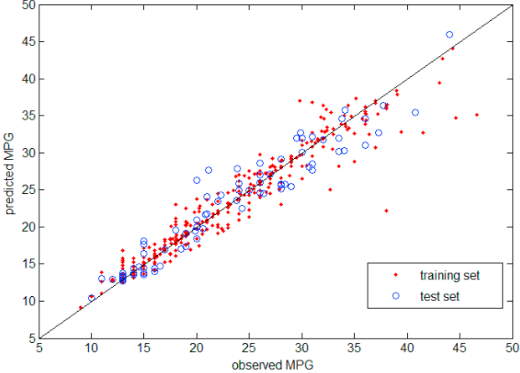
Regression analysis: predicting MPG based on horsepower
1
Regression Model
Using linear regression, we can build a predictive model to estimate a car's miles per gallon (MPG) based on its horsepower. This allows us to understand the relationship between these two variables and make predictions.
2
Model Equation
The regression equation is: MPG = a + b * Horsepower, where a is the y-intercept and b is the slope coefficient. We can estimate the values of a and b from the data.
3
Interpreting the Results
The regression analysis reveals the direction and strength of the relationship between MPG and horsepower. We can use the model to predict MPG given a car's horsepower and understand how changes in horsepower affect fuel efficiency.

Slide 10
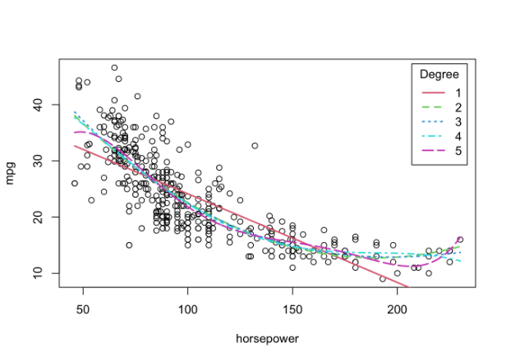
Regression Line Plot: Visualizing the Regression Model
The regression line plot visually depicts the linear relationship between the predictor variable (horsepower) and the response variable (MPG) based on the regression analysis. The plot displays the best-fit line that represents the average MPG value for a given horsepower level.

Slide 11
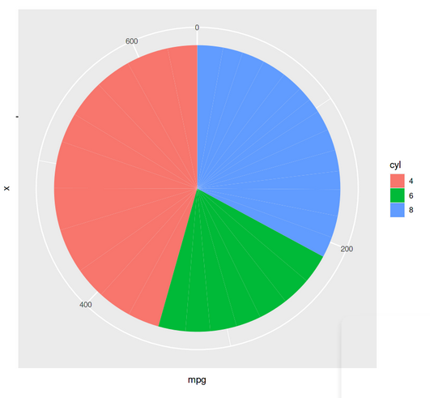
Visualizing the Data Using a Pie Chart
Manual vs. Automatic Transmissions
The pie chart reveals that the majority of the cars in the dataset have manual transmissions, indicating a preference for more engaged driving experiences.
2). Potential Fuel Efficiency Implications
The transmission type can have a significant impact on a car's fuel efficiency, which is an important consideration for many buyers.
3). Relationship to Other Variables
The transmission type may also correlate with other variables, such as engine size or horsepower, providing additional insights into the dataset.

Slide 12

Insights from the Statistical Analysis
Consistent Fuel Efficiency
Wide Range of Horsepower
The mean MPG of 20.09 suggests that the vehicles in the "mtcars" dataset have relatively consistent fuel efficiency, with most models delivering around 20 miles per gallon on average.
The standard deviation of 68.56 horsepower indicates a diverse range of engine power across the vehicles, from economy cars to high-performance sports cars.
Strong Negative Correlation
The correlation analysis reveals a strong negative relationship between MPG and horsepower, demonstrating the tradeoff between fuel efficiency and engine power.

Slide 13
Conclusion and Key Takeaways
Insights Gained
Key Takeaways
The statistical analysis of the "mtcars" dataset has provided valuable insights into the characteristics, relationships, and predictive power of the variables. The exploration of the data distribution, variable correlations, and hypothesis testing has helped uncover meaningful patterns and relationships.
The key takeaways from this analysis include the importance of understanding the underlying data, the need to explore both descriptive and inferential statistics, and the power of visualization techniques in revealing insights. These insights can inform decision-making and guide future research or vehicle design efforts.

